Slide 1
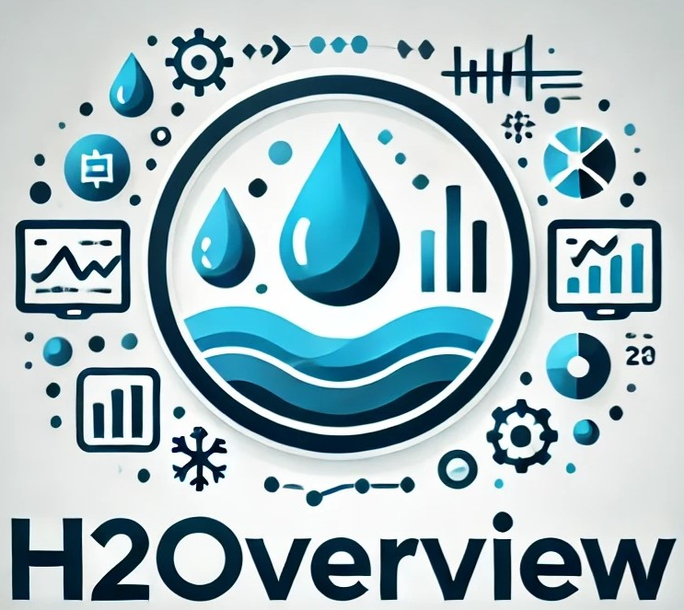

Barwon of a kind
Caring for the environment with data and analytics

Slide 2
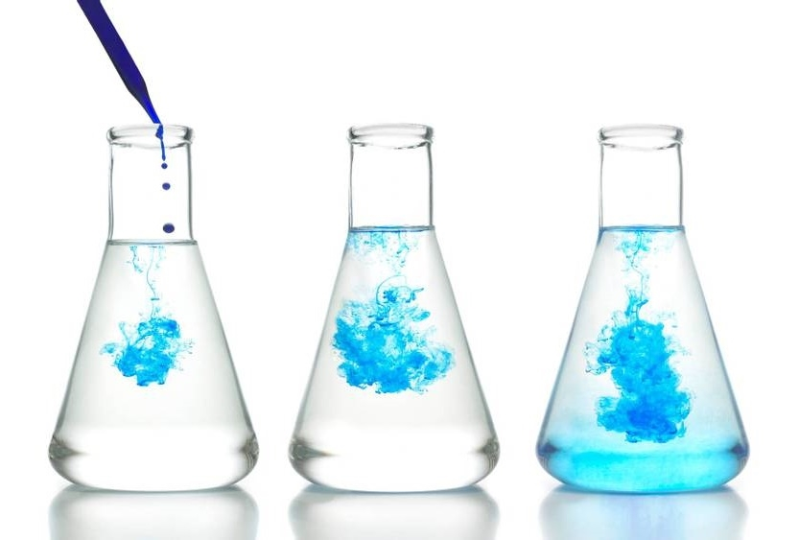
agenda
The team
The opportunity
The solution
How it works
Where to next – the ask

Slide 3

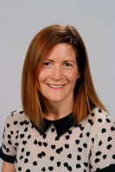
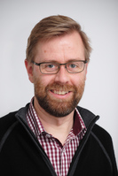
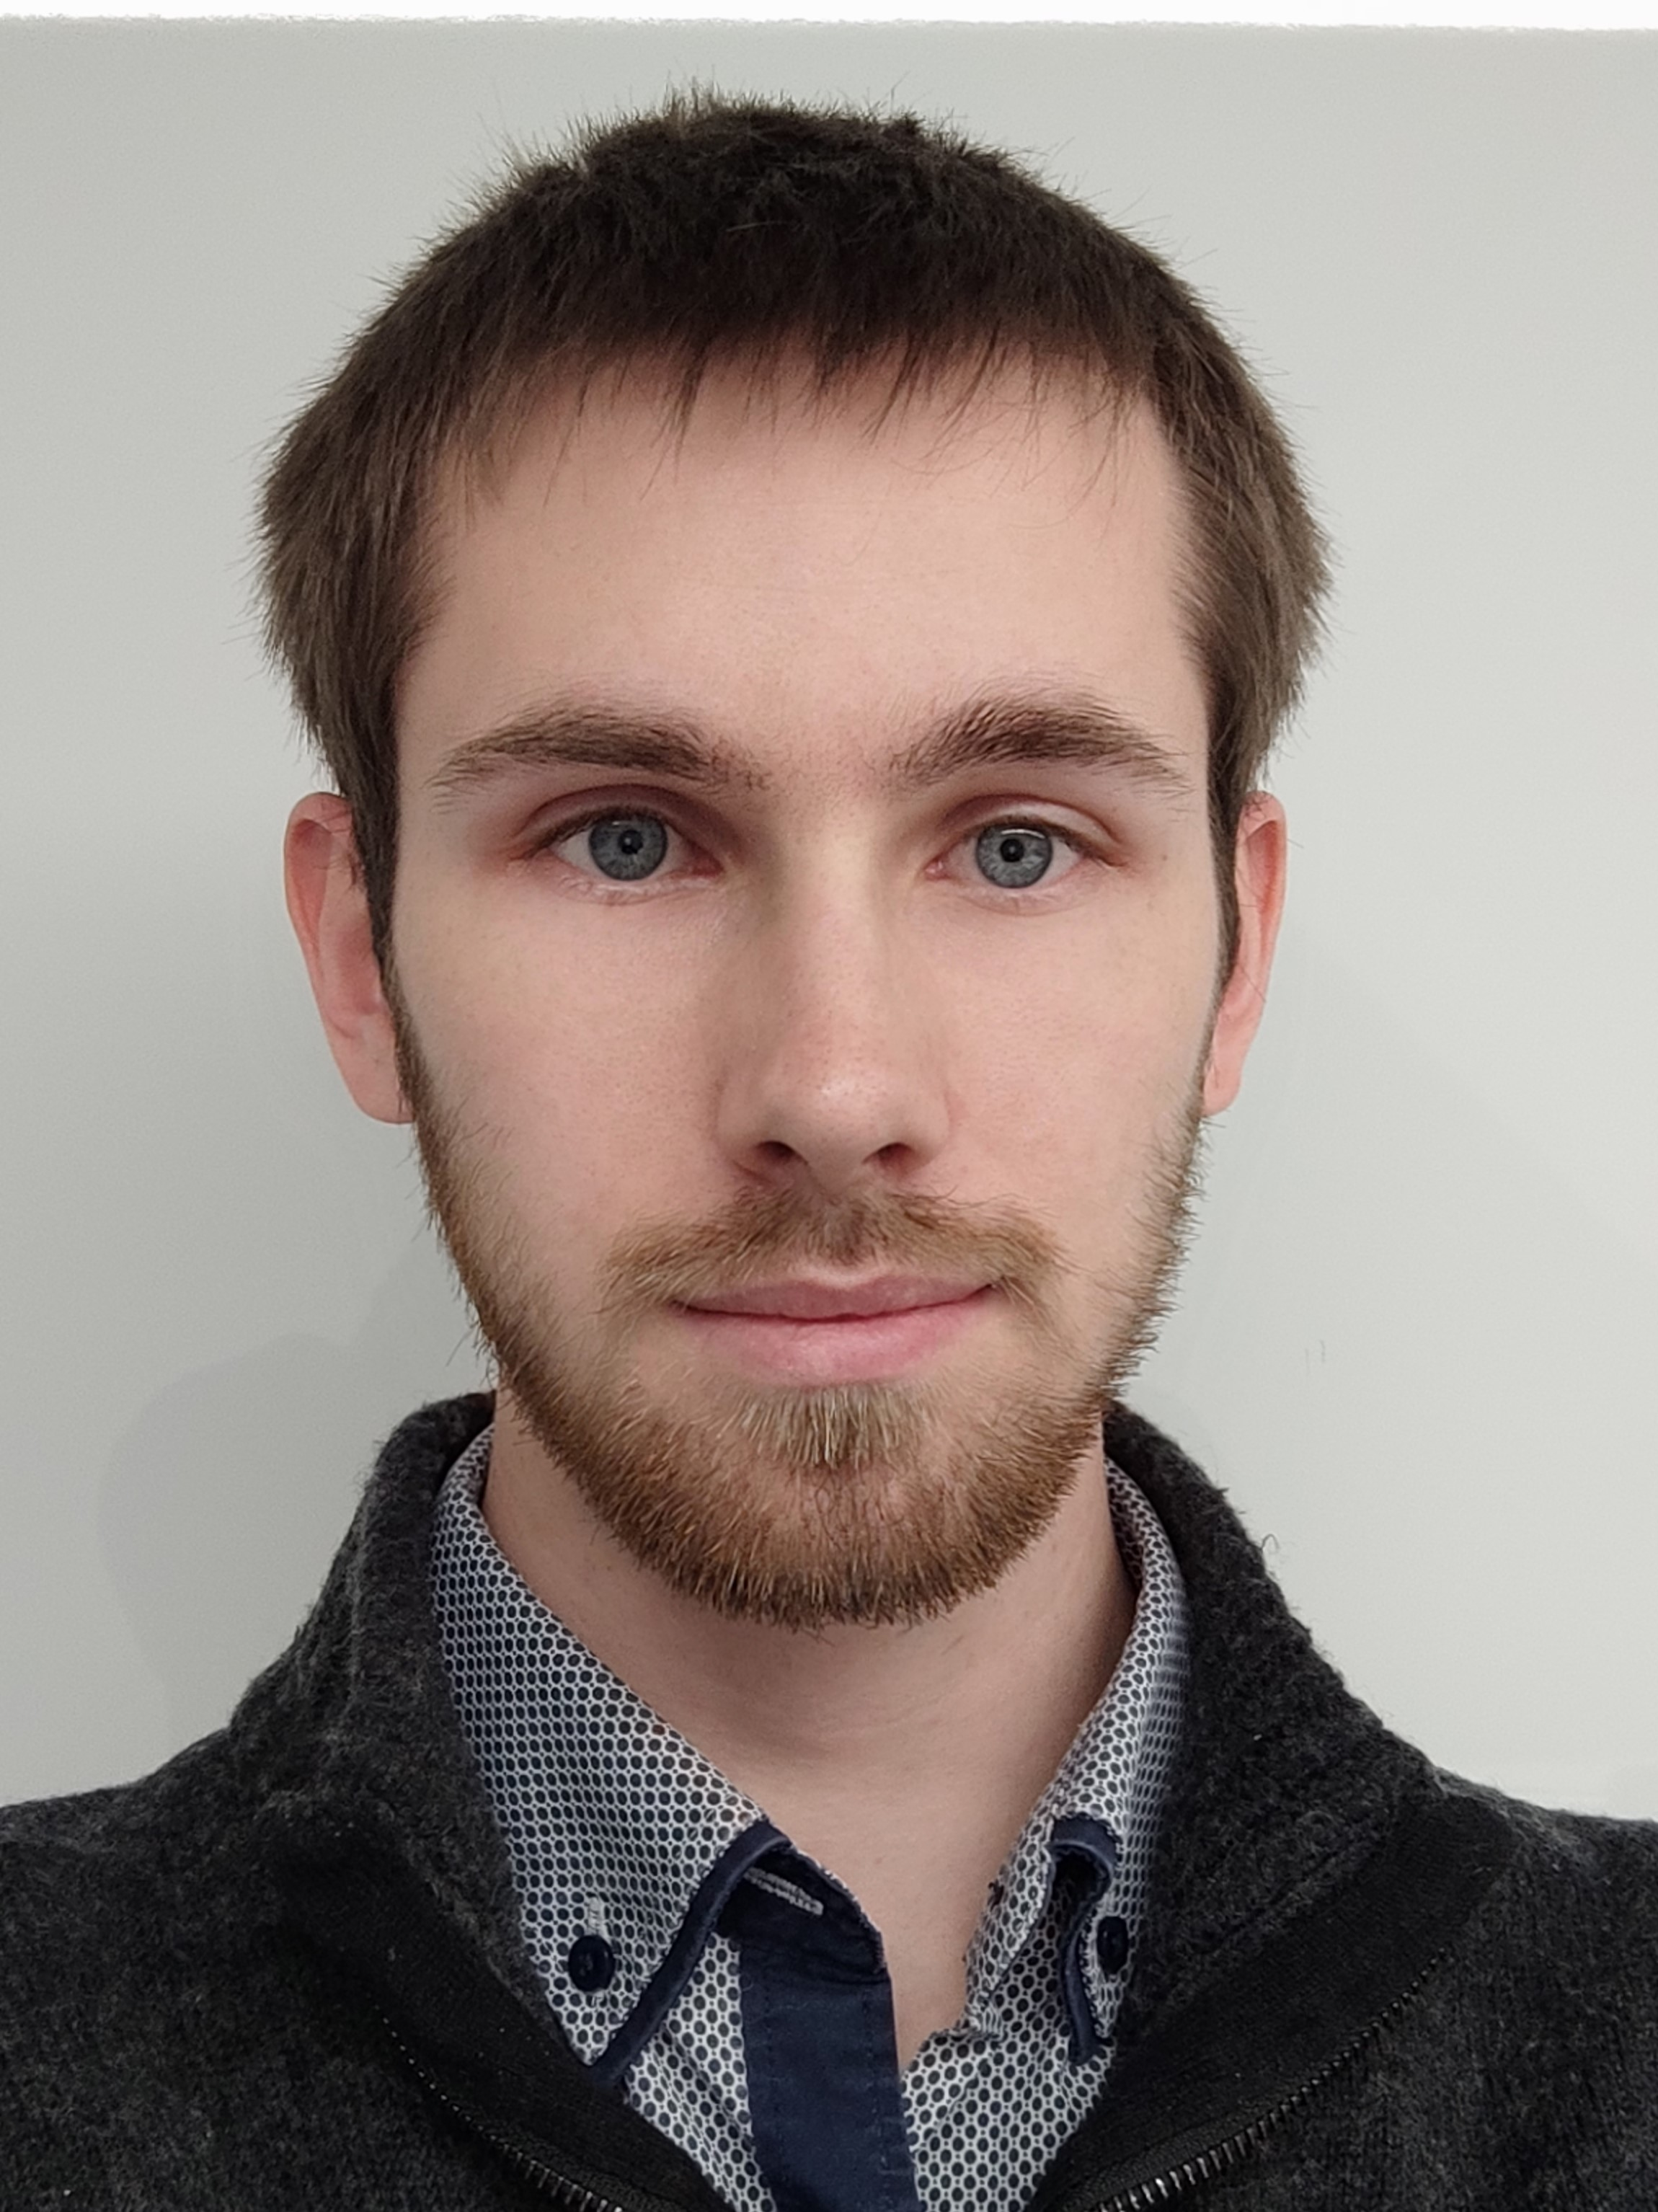
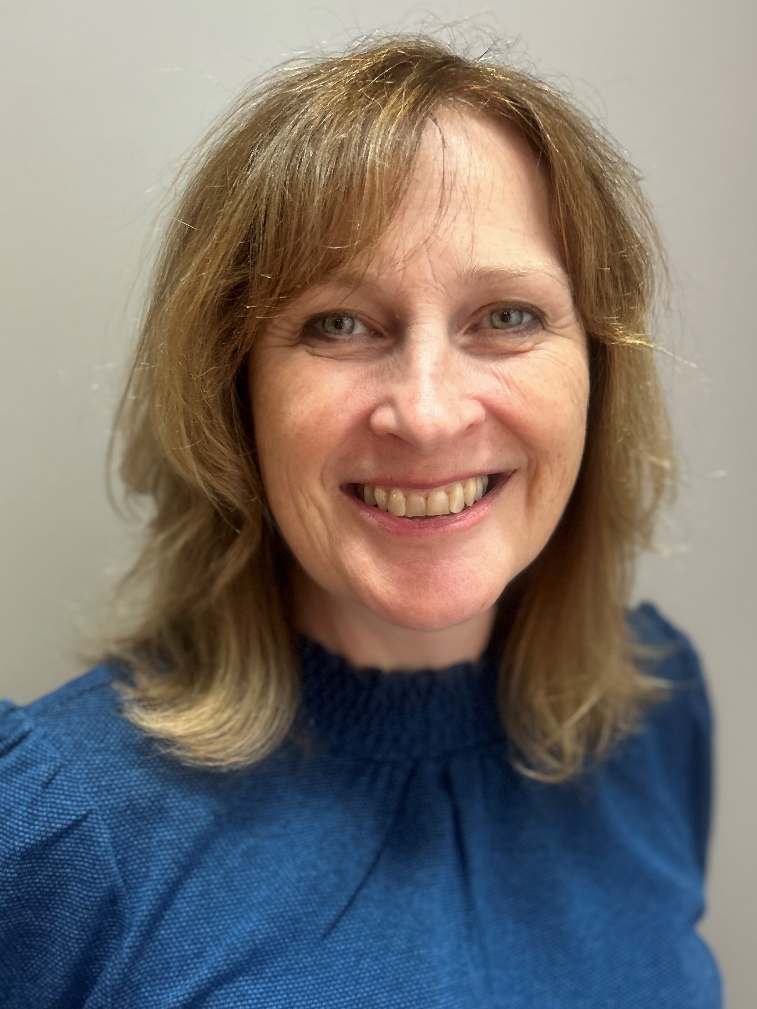
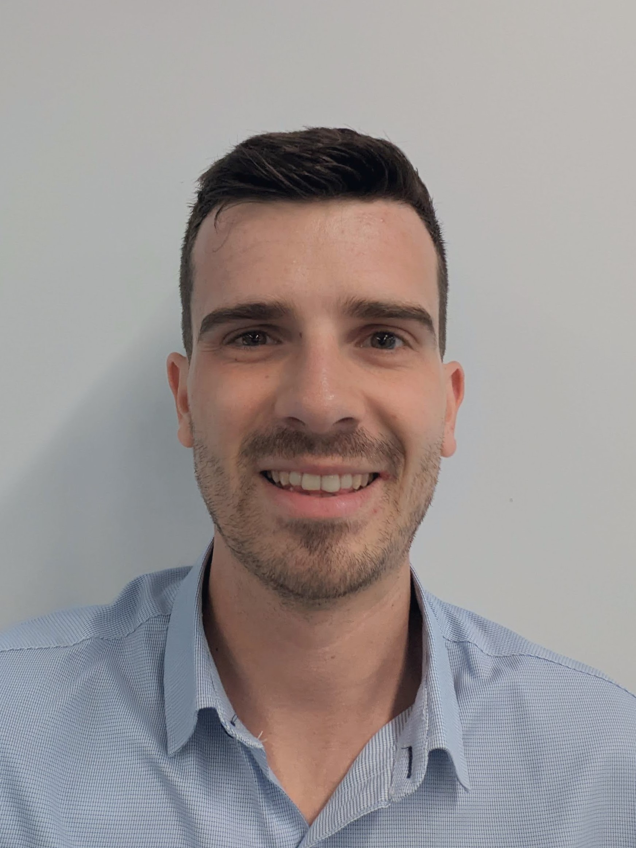
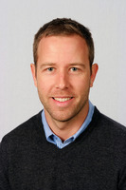
The team
Brigid Creasey
Catchments & Waterways Team Leader
Murray Davidson
Senior Systems & Quality Engineer
Jenny Perks
Design & Improvement Lead
Loch Sharkey
Graduate Engineer (& Genius!)
James Fenton
Drinking Water Quality Team Leader
Tom Murphy
Water Resource Monitoring Team Leader

Slide 4
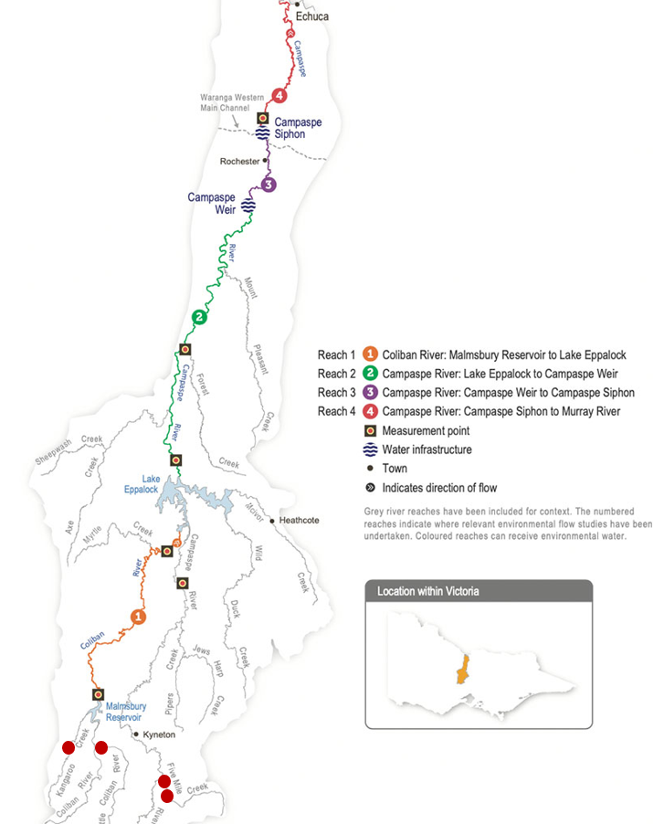
Our stakeholder group
catchment and water quality teams
catchment management authorities

Slide 5
The opportunity
To deploy eco detection sensors within drinking water catchments and combine multiple datasets into a central user-friendly dashboard to:
Highlight opportunities for early intervention
Enable better risk management practices
Deliver improved response time to fluctuations in water quality and events
Increase informed decision-making ability
Save time for staff manipulating data
Improve catchment water quality sampling
Track improvements in water quality and link them to investments in catchment health
Notes:
Early intervention – such as operational decision making, water harvesting, initating aeration, reactive samples, landowner engagement and education, on ground waterway and protection work

Slide 6
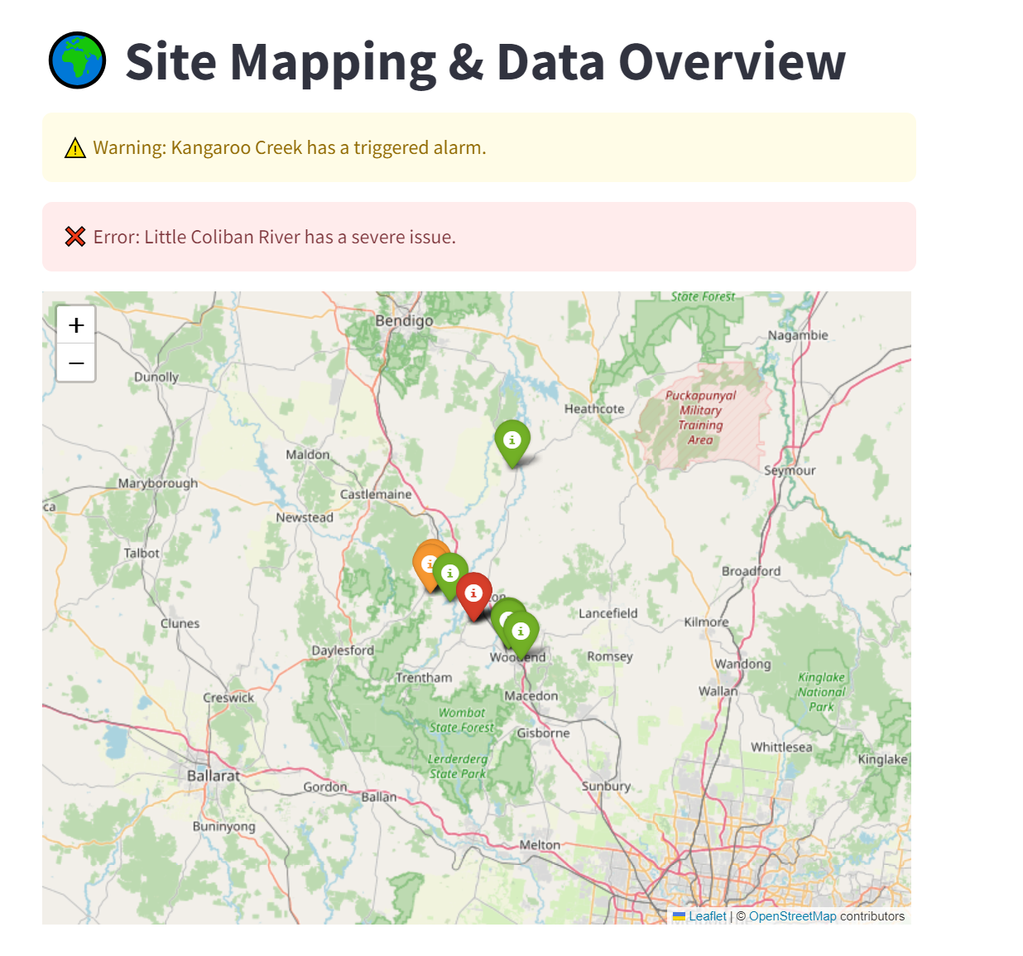
Dashboard design logic
Stakeholder group are data savvy
Needs to be quick and easy to use
Customisable by geographical area and date range
Easy to import data from multiple sources
Capability to generate reports and extract data
Ability to send triggers and alerts
Geographical overview
Ability to compare and correlate different data sets

Slide 7

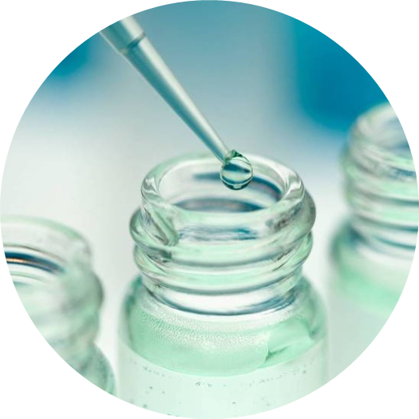
H2Overview Dashboard
The dashboard is a Python-based application using Plotly for data visualization, hosted on Streamlit Cloud, with interactive map and alarm features powered by Folium.
H2Overview Dashboard (lsharkey.tech)
Data collection map
Water quality comparison
Rainfall & streamflow
alerts
Ai assistant
Interactive data visualisation
Check it out yourself!
Notes:
The dashboard is a python based application using Plotly and hosted on Streamlit
The front page outlines the site and links to an AI bot for speedy data insights
We’re using all the datasets provided
And you can see an example of the trend of the eco dectection water quality data
You can see we can select for sensor location and we can customise data views
Here is the rainfall and streamflow data customisable by view and date range
And critically we can compare datasets – for example the eco detection sensors compared with the water quality lab data
We can change between sites and can see correlations to validate the data integrity
We can turn off outliers – to give another view, and select date range
An additional benefit is that we have the ability to set alarms and limits - for example this can be informed by Australian Drinking Water Guideline limits, EPA licenses or fresh and marine water quality guidelines.
And here you can see an alarm history present to guidelines
Here we see the geographical area overlaid with rainflow, streamflow, lab sample points, eco detect sensors, temperature data and a live view of alerts or alarms and their severity
Finally the ability to create reports and or export data

Slide 8
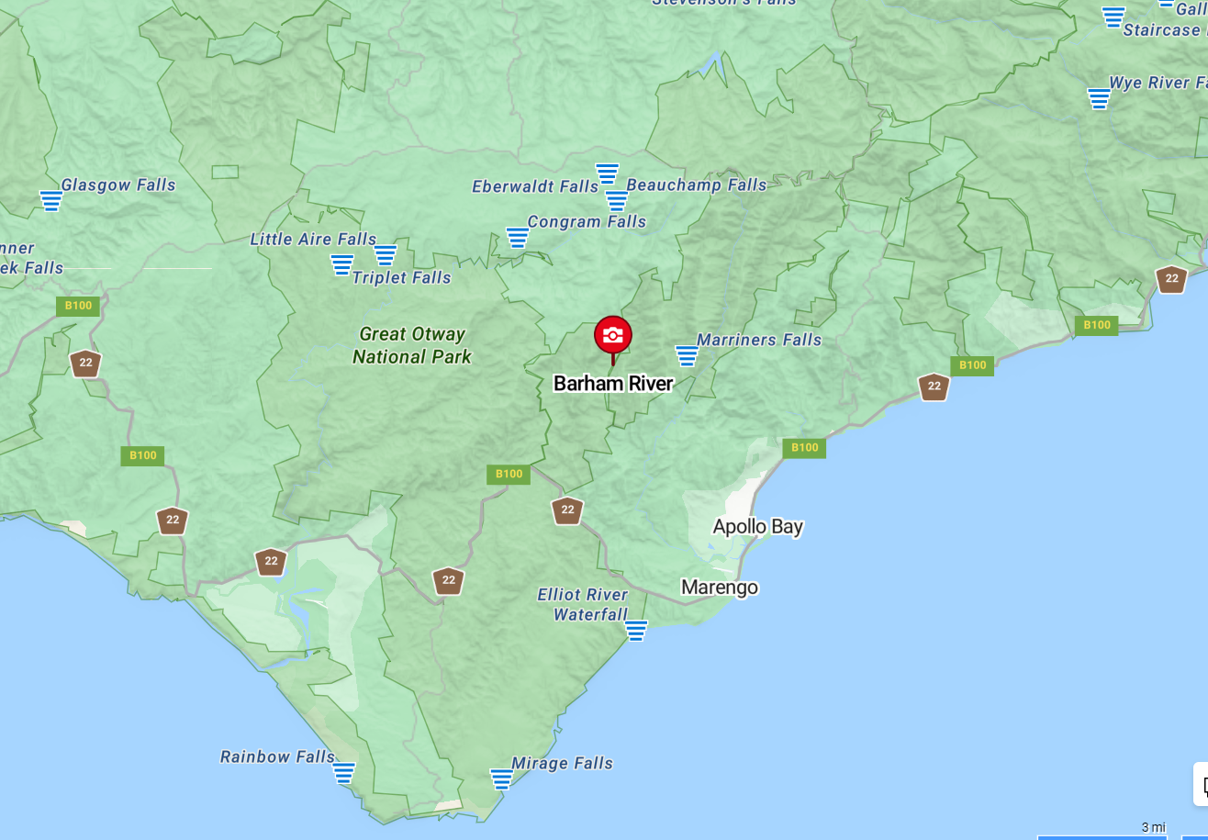
Making this happen - our ask…
Support to build out the dashboard $20k
Stakeholder engagement
Requirement identification
Developer time to build
Support for four EcoDetection sensor deployment trial in our highest risk catchment Barham River Apollo Bay to support a catchment-based improvement project

Slide 9
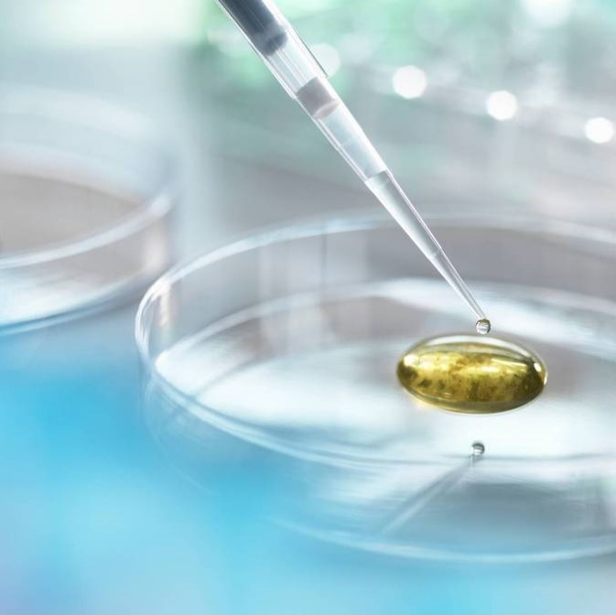
Thank you
Barwon of a kind

